Slide 1
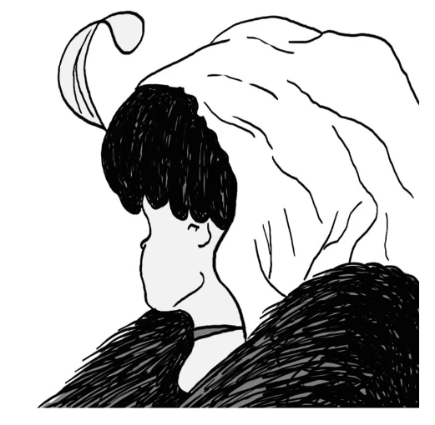

Convolutional Neural Networks
Notes:
Young lady looking away or old lady looking down?

Slide 2




Slide 3
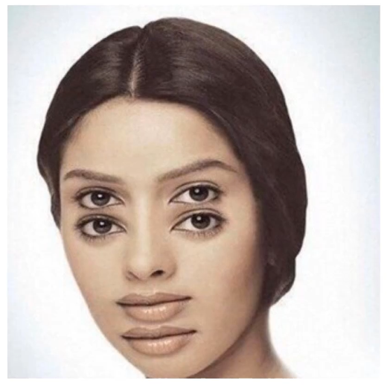

Slide 4
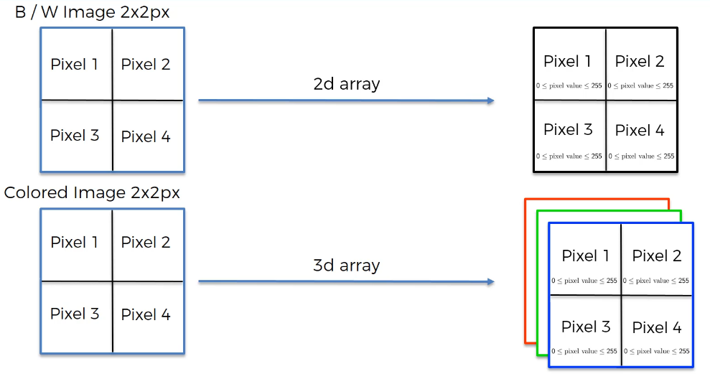

Slide 5
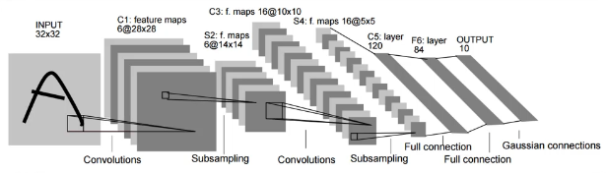
CNN Steps
Convolution (with ReLU)
Max Pooling
Flattening
Full Connection

Slide 6
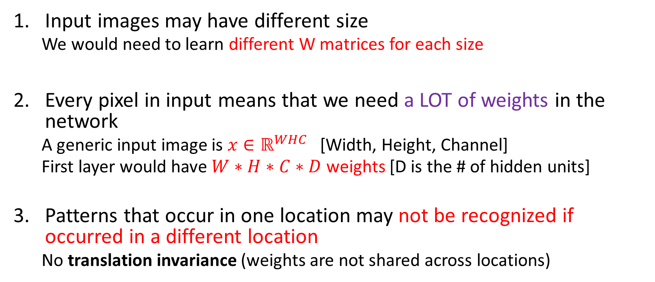
Why Convolution? To solve 3 main problems
Input images may have different size
We would need to learn different W matrices for each size
Every pixel in input means that we need a LOT of weights in the network
A generic input image is $x∈ℝ^{WHC}$ [Width, Height, Channel]
First layer would have $W∗H∗C∗D$ weights [D is the # of hidden units]
Patterns that occur in one location may not be recognized if occurred in a different location
No translation invariance (weights are not shared across locations)
Notes:
RGB, for example, has 3 channels

Slide 7
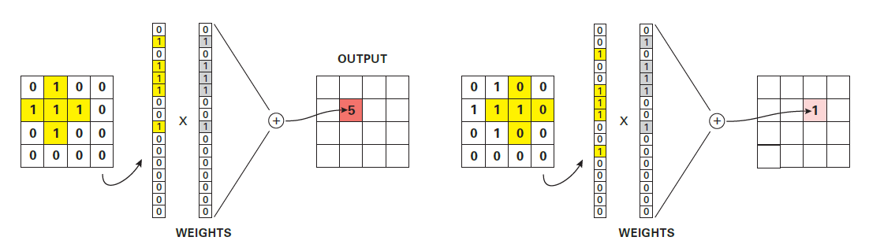
Why Convolution? To solve 3 main problems
We can design a weight vector to act as a matched filter for detecting the desired cross-shape
This will give a strong response of 5 if the object is on the left, but a weak response of 1 if the object is shifted over to the right
Notes:
<src. Probabilistic Machine Learning, Kevin P. Murphy>

Slide 8
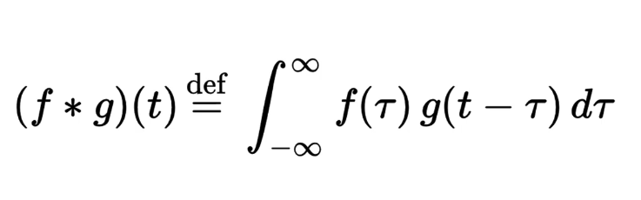
Step 1 - Convolution
This is the transformation in mathematical terms
The verb to use is “to convolve”
That translated from Math is ‘to combine’

Slide 9
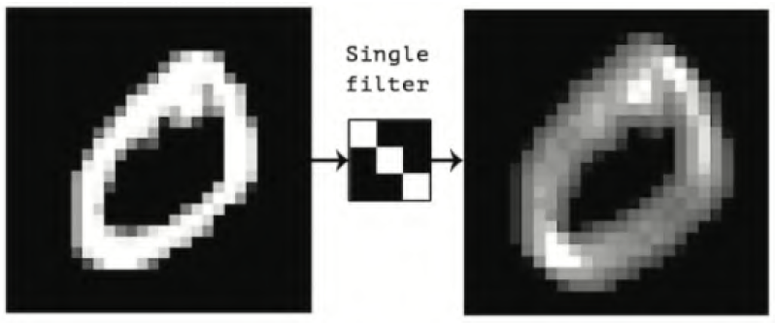
Step 1 - Convolution
Example of a Feature Detector (aka filter)
Note that the bright spots occur where the filter pattern appears in the original picture

Slide 10
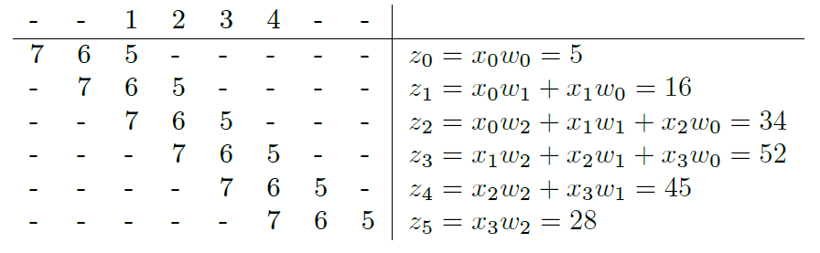
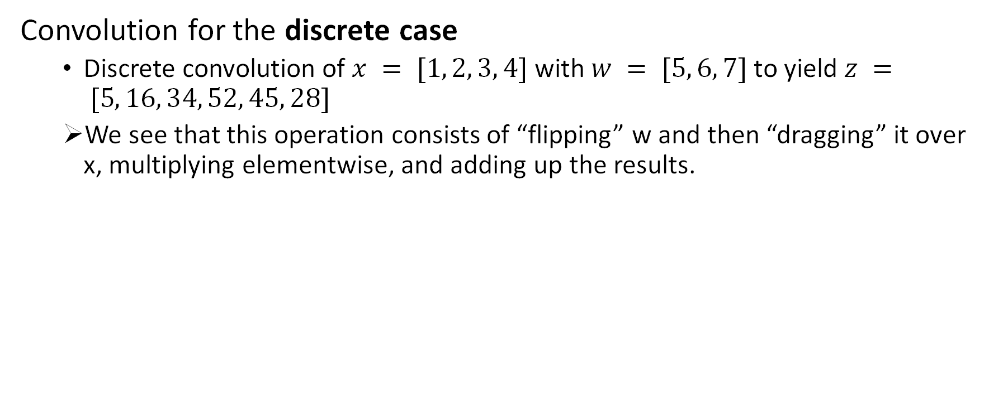
Step 1 - Convolution
Convolution for the discrete case
Discrete convolution of $x = [1, 2, 3, 4]$with $w = [5, 6, 7]$to yield $z = [5, 16, 34, 52, 45, 28]$
We see that this operation consists of “flipping” w and then “dragging” it over x, multiplying elementwise, and adding up the results.

Slide 11
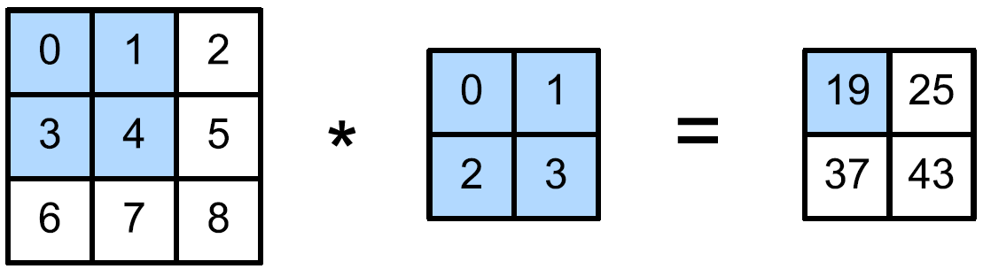
Step 1 - Convolution
Example of 1D Convolution
Example of 2D Convolution
Notes:
Note that the actual name for convolution should be cross correlation

Slide 12
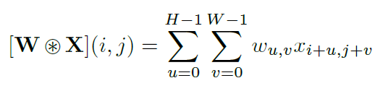
Step 1 - Convolution
Example of 2D Convolution
Notes:
where the 2d filter W has size H and W

Slide 13
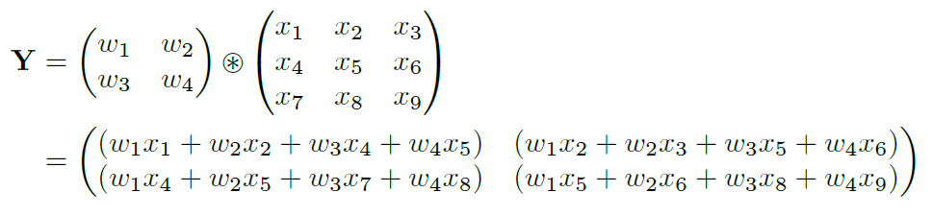
Step 1 - Convolution
For example, convolving a (3 x 3) input X with a (2 x 2) filter to compute a (2 x 2) output Y:
Notes:
where the 2d filter W has size H and W

Slide 14
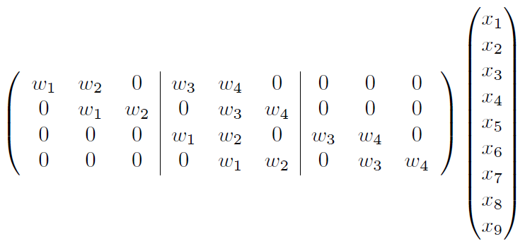
Since convolution is a linear operator, we can represent it by matrix multiplication:

Slide 15
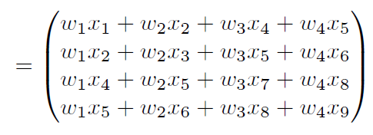
CNNs are similar to MLPs, but their weight matrices have a special sparse structure
Elements are tied across spatial locations, achieving translation invariance and significantly reducing the number of parameters compared to standard fully connected layers in MLPs.

Slide 16
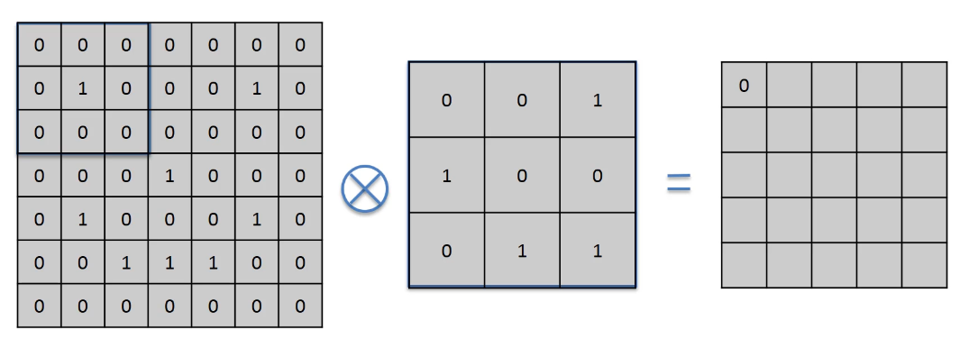
We multiply together the elements of these 3x3 matrices, position by position.
Then, we sum all the results together
All the multiplications are 0x1 or 1x0, so the sum is equal to 0
Input Image
Simplified as just 1s and 0s per pixel
Feature Detector
AKA Filter
Usually, 3x3 but it could be larger
It can contain negative values too
Feature Map
Simplified as just 1s and 0s per pixel
Notes:
The Feature Map can also be called Convolved map or Activation map

Slide 17
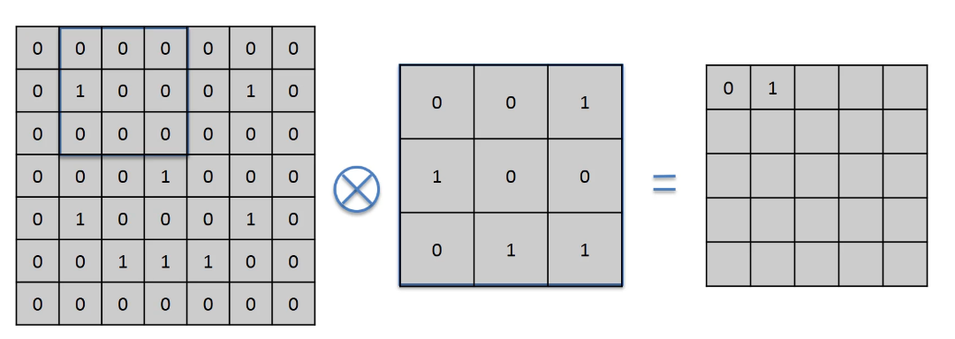
We multiply together the elements of these 3x3 matrices, position by position.
Then, we sum all the results together
Now, one multiplication is 1x1
Input Image
Simplified as just 1s and 0s per pixel
Feature Detector
AKA Filter
Usually, 3x3 but it could be larger
It can contain negative values too
Feature Map
Simplified as just 1s and 0s per pixel

Slide 18
The movement of this matrix is called stride
Here we have a stride of 1 pixel
Input Image
Simplified as just 1s and 0s per pixel
Feature Detector
AKA Filter
Usually, 3x3 but it could be larger
It can contain negative values too
Feature Map
Simplified as just 1s and 0s per pixel

Slide 19
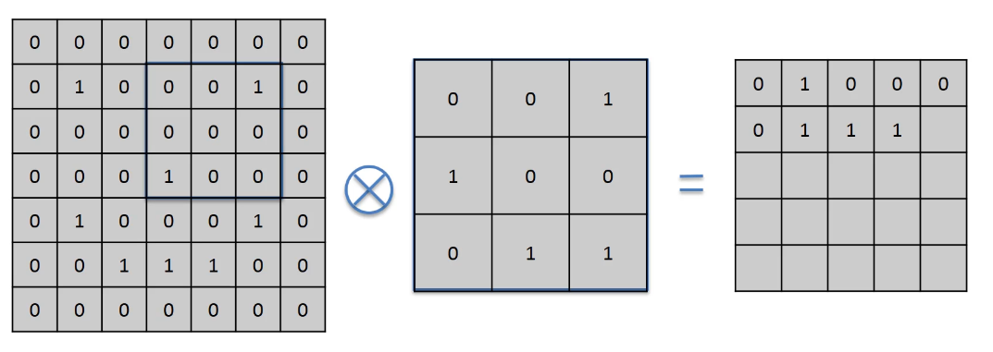
After 10 strides
Best values for the stride is by 1 or 2 pixels
Input Image
Simplified as just 1s and 0s per pixel
Feature Detector
AKA Filter
Usually, 3x3 but it could be larger
It can contain negative values too
Feature Map
Simplified as just 1s and 0s per pixel

Slide 20
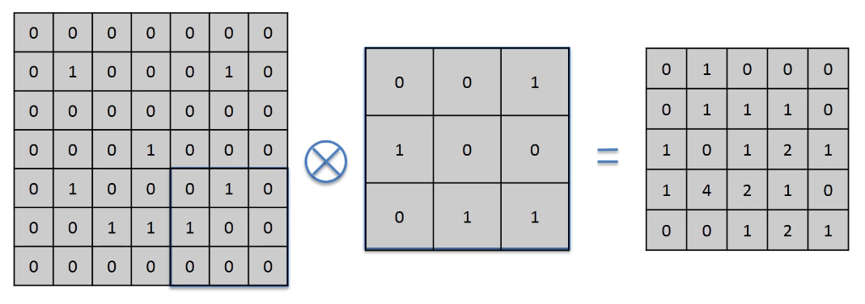
Input Image
Simplified as just 1s and 0s per pixel
Feature Detector
AKA Filter
Usually, 3x3 but it could be larger
It can contain negative values too
Feature Map
Simplified as just 1s and 0s per pixel

Slide 21
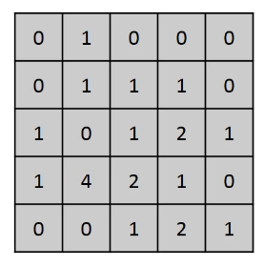
Step 1 - Convolution
What is the Feature Map? What did we obtain?
We reduced the size of the original matrix
The more the larger is the stride
The higher are the numbers, the more precisely the detected feature appears in the original image
Note that it still preserves the spatial relationships between pixels
We don’t lose the pattern

Slide 22
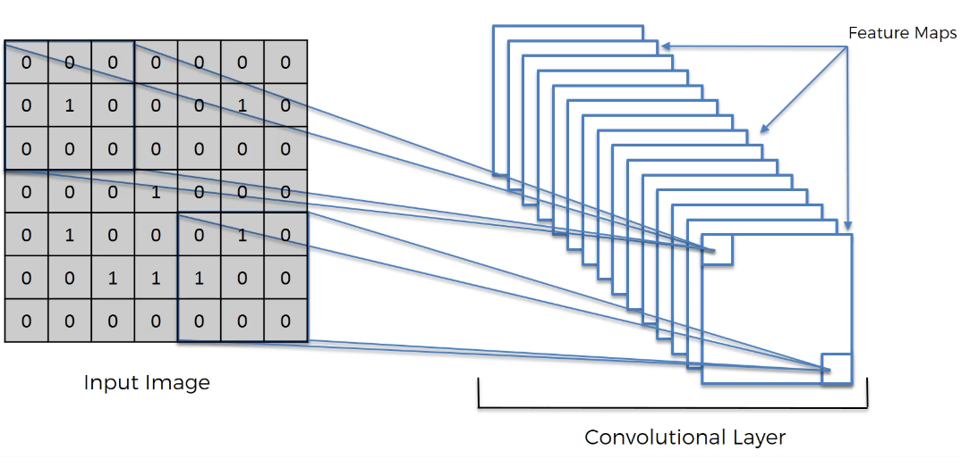
The network will be trained to recognize a series of Features that are then stored in a collection of Feature Maps
This is the Convolutional Layer

Slide 23
Step 1 - Convolution
Can I have convolution that mantains the size of the original image?
Yes, it is called Same Convolution, and it uses zero-padding
It basically adds a border of 0s to the image
Notes:
The lady in the picture is called Lenna
If you transpose the matrix, you get Vertical edge instead

Slide 24
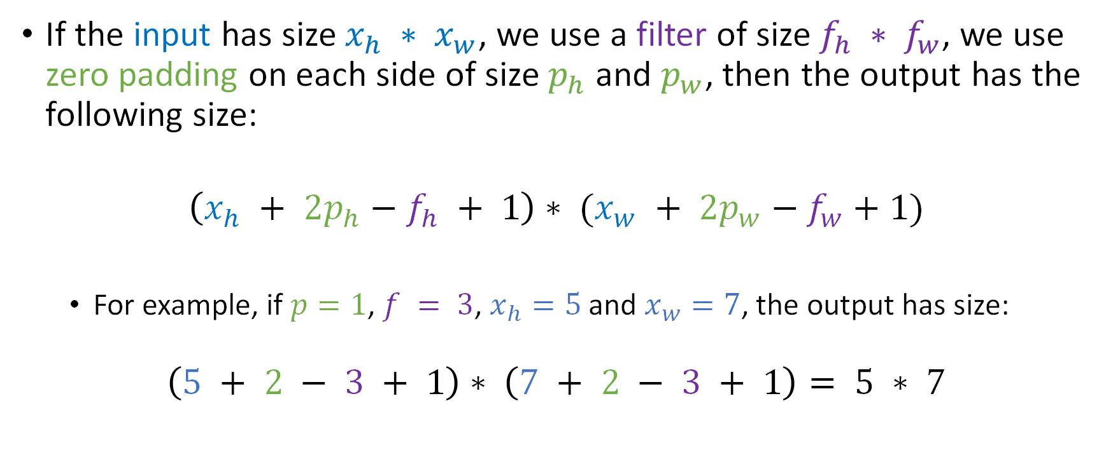
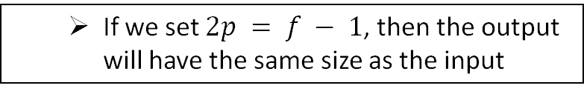
How big is the Feature Map?
If the input has size $x_{h} ∗ x_{w}$, we use a filter of size $f_{h} ∗ f_{w}$, we use zero padding on each side of size $p_{h}$ and $p_{w}$, then the output has the following size:
$$\left(x_{h} + 2p_{h}−f_{h} + 1\right)∗ (x_{w} + 2p_{w}−f_{w}+1)$$
For example, if $p=1$, $f = 3$, $x_{h}=5$ and $x_{w}=7$, the output has size:
$$\left(5 + 2 − 3 + 1\right)∗ \left(7 + 2 − 3 + 1\right)= 5 ∗ 7$$
If we set $2p = f − 1$, then the output will have the same size as the input

Slide 25
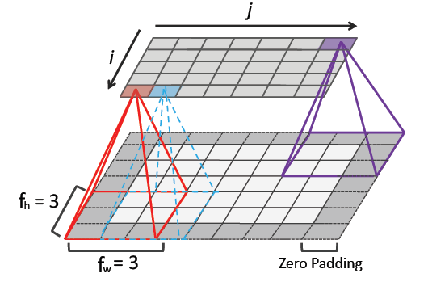
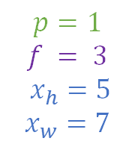
$$\left(x_{h} + 2p_{h}−f_{h} + 1\right)∗ (x_{w} + 2p_{w}−f_{w}+1)$$
$$p=1$$
$$f = 3$$
$x_{h}=5$
$$x_{w}=7$$
$$\left(5 + 2 − 3 + 1\right)∗ \left(7 + 2 − 3 + 1\right)= 5 ∗ 7$$

Slide 26
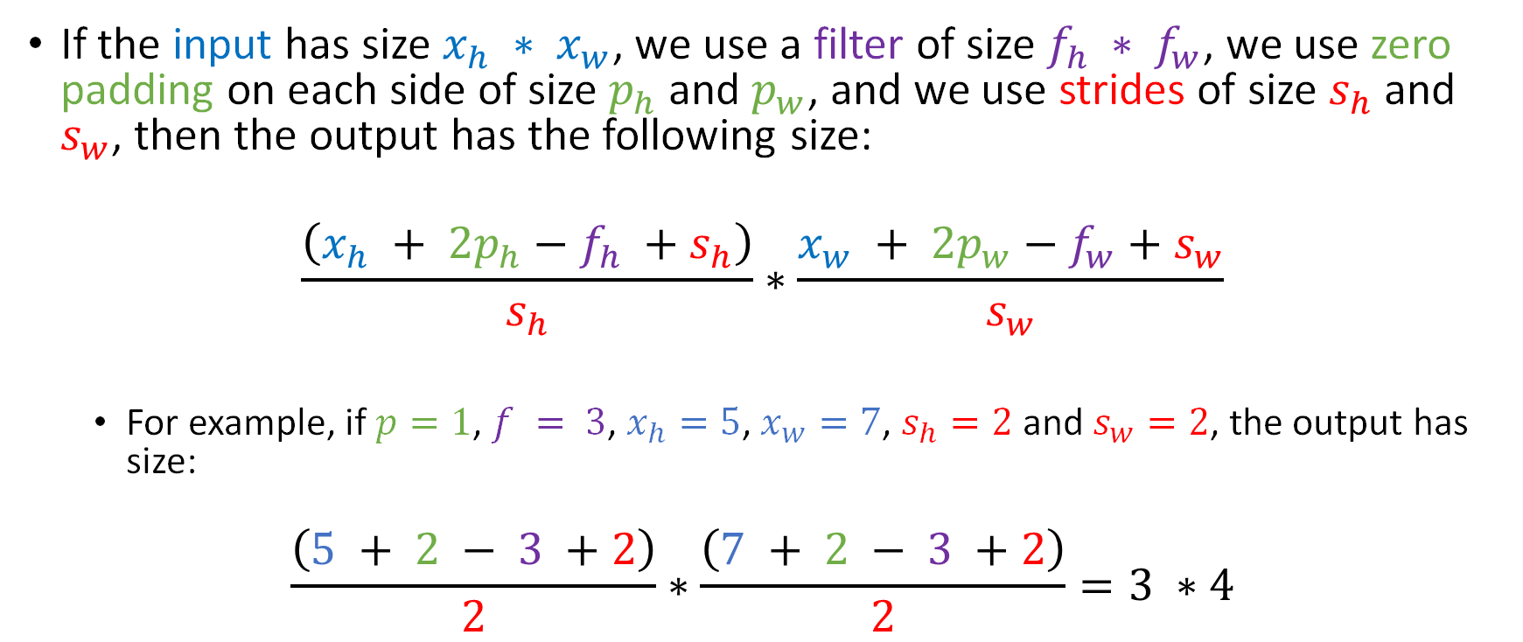
How stride affects the size of the Feature Map?
If the input has size $x_{h} ∗ x_{w}$, we use a filter of size $f_{h} ∗ f_{w}$, we use zero padding on each side of size $p_{h}$ and $p_{w}$, and we use strides of size $s_{h}$ and $s_{w}$, then the output has the following size:
$$\frac{\left(x_{h} + 2p_{h}−f_{h} +s_{h}\right)}{s_{h}}∗\frac{x_{w} + 2p_{w}−f_{w}+s_{w}}{s_{w}}$$
For example, if $p=1$, $f = 3$, $x_{h}=5$, $x_{w}=7$, $s_{h}=2$ and $s_{w}=2$, the output has size:
$$\frac{\left(5 + 2 − 3 +2\right)}{2}∗\frac{\left(7 + 2 − 3 +2\right)}{2}=3 ∗4$$

Slide 27
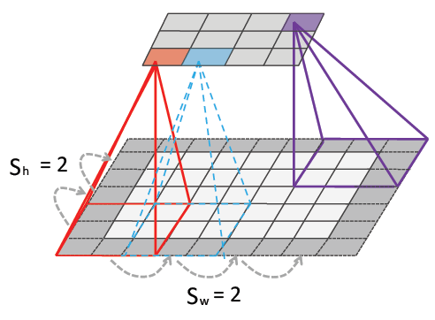
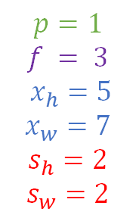


$$\frac{\left(x_{h} + 2p_{h}−f_{h} +s_{h}\right)}{s_{h}}∗\frac{x_{w} + 2p_{w}−f_{w}+s_{w}}{s_{w}}$$
$$p=1$$
$$f = 3$$
$x_{h}=5$
$$x_{w}=7$$
$$s_{h}=2$$
$$s_{w}=2$$
$$\frac{\left(5 + 2 − 3 +2\right)}{2}∗\frac{\left(7 + 2 − 3 +2\right)}{2}=3 ∗4$$

Slide 28
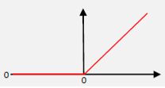
Step 1 - Convolution
After creating the set of Feature Maps, we need to add some non-linearity
We apply the Rectifier activation function (ReLU)
All the negative values are filtered out
This helps reducing the graduality of the color palette.
Example: In a picture, colors go from bright to dark gradually.
If we remove the negatives, it will change more abruptly. Less linearly!

Slide 29
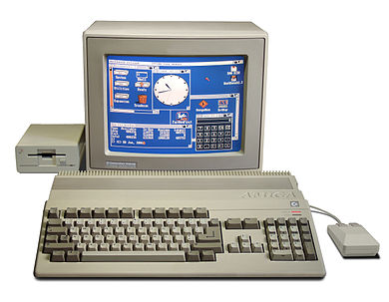
Step 2 - Pooling
Convolution, though, has equivariance
It preserves info about the location of the patterns
We need to ensure that our neural network has a property called translation invariance
Basically, that it doesn't care where the features are and doesn't care if the features are a bit tilted, different, relatively closer or farer apart, and so on.
Notes:
Commodore Amiga 500 <src=‘Wikipedia’>

Slide 30
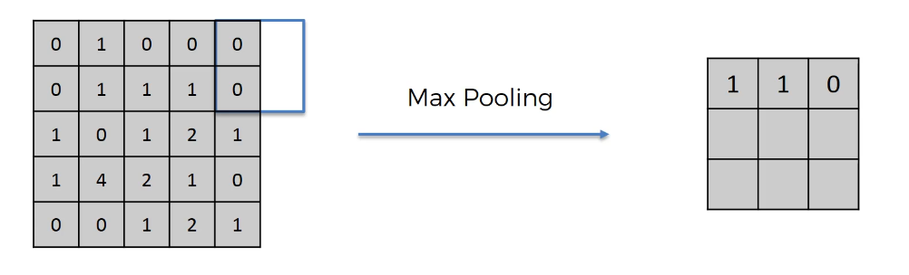
Step 2 - Pooling
Feature Map
We pick the maximum value in a 2x2 sub-square (the size can vary)
Stride is 2 here, but it can vary
If at the end of the row, we just continue
Pooled Feature Map
Each position contains the maximum value found in the sub-squares
Notes:
Note: there are also other types of pooling, like average and mean

Slide 31
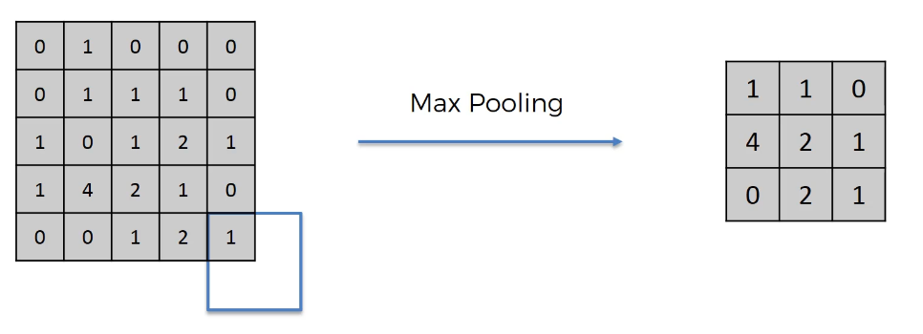
Step 2 - Pooling
Feature Map
We pick the maximum value in a 2x2 sub-square (the size can vary)
Stride is 2 here, but it can vary
If at the end of the row, we just continue
Pooled Feature Map
Each position contains the maximum value found in the sub-squares

Slide 32
Step 2 - Pooling
Feature Map
We pick the maximum value in a 2x2 sub-square (the size can vary)
Stride is 2 here, but it can vary
If at the end of the row, we just continue
Pooled Feature Map
Each position contains the maximum value found in the sub-squares

Slide 33
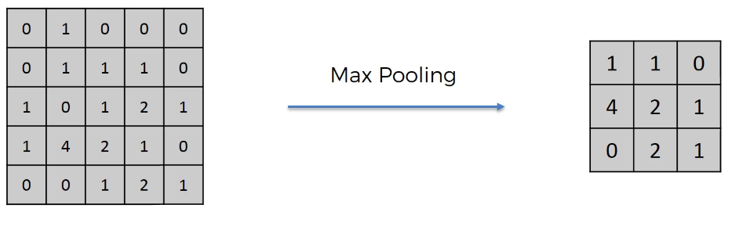
Step 2 - Pooling
Feature Map
Pooled Feature Map
In the Pooled Feature Map, we pick the maximum value in a small area (the sub-square)
If in the Feature Map, the maximum value is moved in a different position, it will still be recognized and passed to the Pooled Feature Map
We are also reducing the size of the Map, helping the work of the final layer
Also, it reduces overfitting, because we are not training on the actual training data anymore

Slide 34
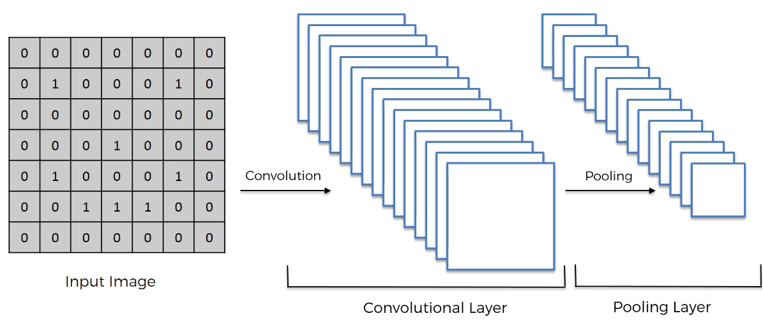
Convolution + Pooling
Note: Pooling is applied to any Convolutional Layer

Slide 35
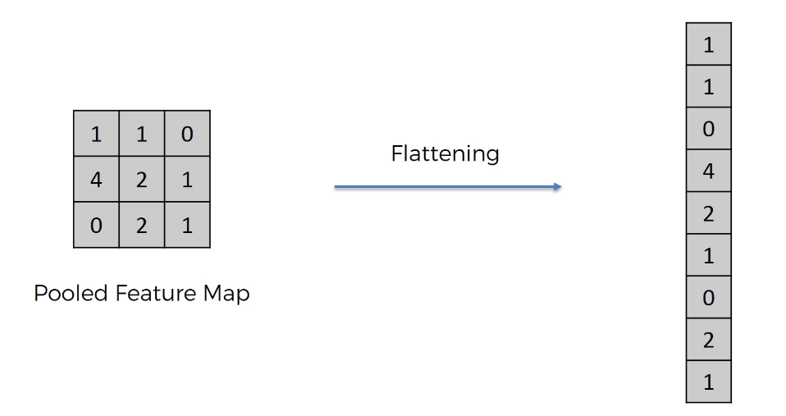
Step 3 - Flattening
Simply, we convert the matrices in a vector (by rows)

Slide 36
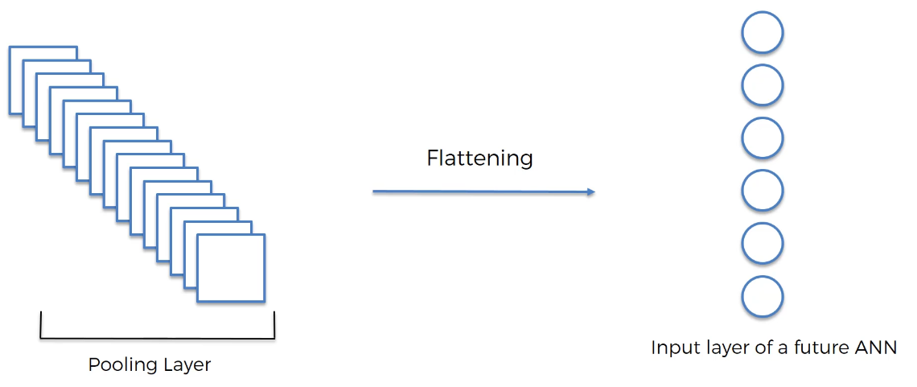
Step 3 - Flattening
Simply, we convert the matrices in a vector (by rows)

Slide 37
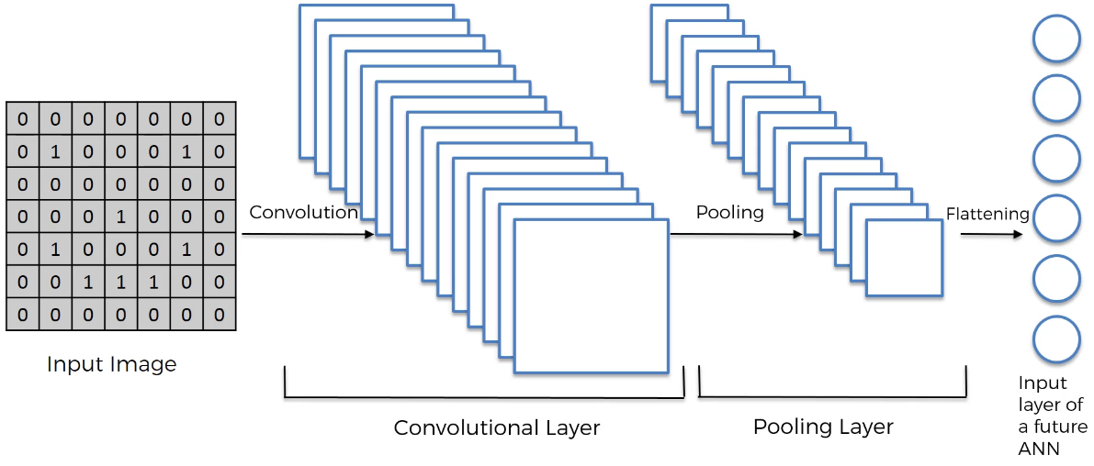
Convolution + Pooling + Flattening

Slide 38
Step 4 – Full Connection
We finally attach the ANN
Input Layer
Output Layer
Fully Connected Layers
Note that in CNNs, the hidden layers are called “Fully Connected Layers”
Notes:
We could have more Hidden Layers, of course
Note: the Flattening output should have the same number of “nodes” as the Input Layer (the image lacks a couple).

Slide 39
Step 4 – Full Connection
Input Layer
In this network, though, the backpropagation will not simply identify the weights to update, but also the “features”
In fact, the Feature Detectors are also modified based on the error (via gradient descent)
Output Layer
Fully Connected Layer/s
Notes:
We could have more Hidden Layers, of course
Note: the Flattening output should have the same number of “nodes” as the Input Layer (the image lacks a couple).

Slide 40
Step 4 – Full Connection
Input Layer
In this network, though, the backpropagation will not simply identify the weights to update, but also the “features”
In fact, the Feature Detectors are also modified based on the error (via gradient descent)
Output Layer
Fully Connected Layer/s
Notes:
We could have more Hidden Layers, of course
Note: the Flattening output should have the same number of “nodes” as the Input Layer (the image lacks a couple).

Slide 41
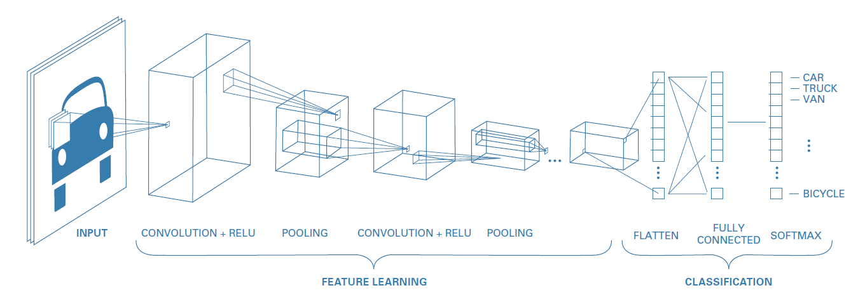
Step 4 – Full Connection
Notes:
We could have more Hidden Layers, of course
Note: the Flattening output should have the same number of “nodes” as the Input Layer (the image lacks a couple).

Slide 42
What if we add more Convolutional and Pooling layers?
The network will become very deep…
Vanishing or exploding gradient problem!
Notes:
We could have more Hidden Layers, of course
Note: the Flattening output should have the same number of “nodes” as the Input Layer (the image lacks a couple).

Slide 43
Vanishing or Exploding gradient
A common solution to this problem is to add extra layers to the model
Layers that reduce overfitting!
We want to standardize the statistics of the hidden units
Zero mean and unit variance
This is similar to input standardization
Alternatively, we can modify the Loss function to penalize greater weight values

Slide 44
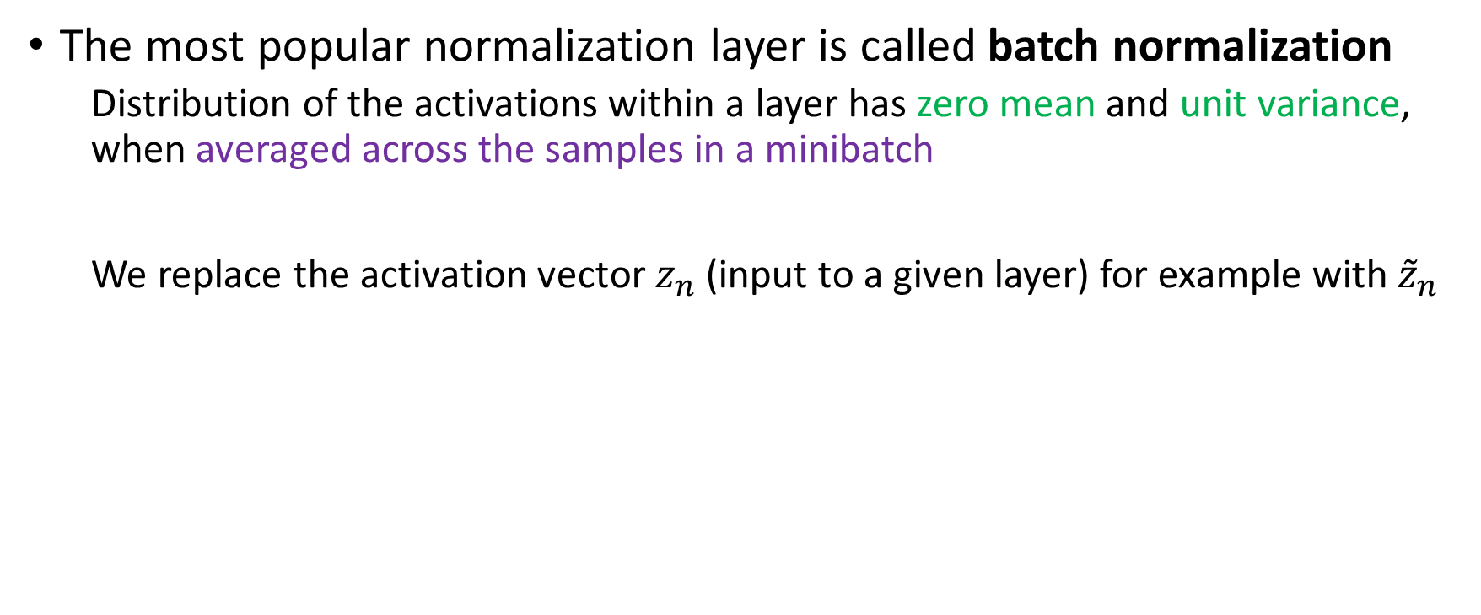
Batch Normalization
The most popular normalization layer is called batch normalization
Distribution of the activations within a layer has zero mean and unit variance, when averaged across the samples in a minibatch
We replace the activation vector $z_{n}$ (input to a given layer) for example with ${\tilde{z}}_{n}$
Notes:
Sometimes we can replace the pre-activation vector instead

Slide 45
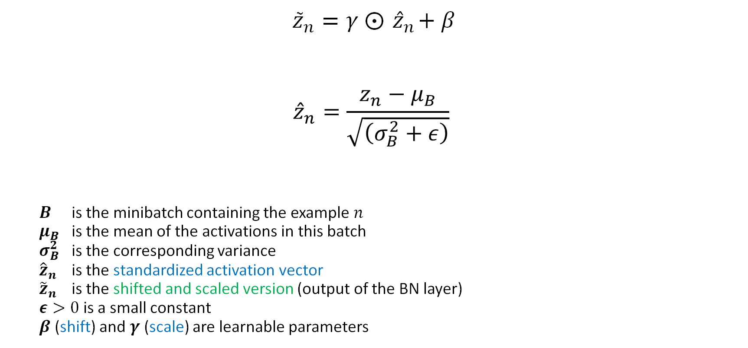
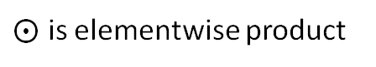
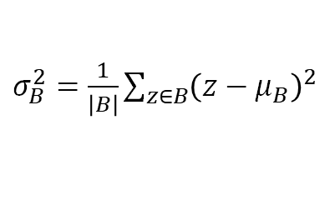
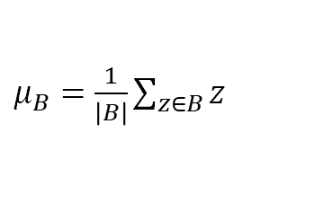
Batch Normalization
$${\tilde{z}}_{n}=γ ⨀{ \hat{z}}_{n}+β$$
$${\hat{z}}_{n}=\frac{z_{n}−μ_{B}}{\sqrt{\left(σ_{B}^{2}+ε\right)}}$$
$B$ is the minibatch containing the example $n$
$μ_{B}$ is the mean of the activations in this batch
$σ_{B}^{2}$ is the corresponding variance
${\hat{z}}_{n}$ is the standardized activation vector
${\tilde{z}}_{n}$ is the shifted and scaled version (output of the BN layer)
$ε>0$ is a small constant
$β$ (shift) and $γ$ (scale) are learnable parameters
$μ_{B}=\frac{1}{\left|B\right|}\sum_{z∈B}{z}$
$σ_{B}^{2}=\frac{1}{\left|B\right|}\sum_{z∈B}{{\left(z−μ_{B}\right)}^{2}}$
$⨀$ is elementwise product
Notes:
When applied to the input layer, batch normalization is equivalent to the usual standardization procedure

Slide 46
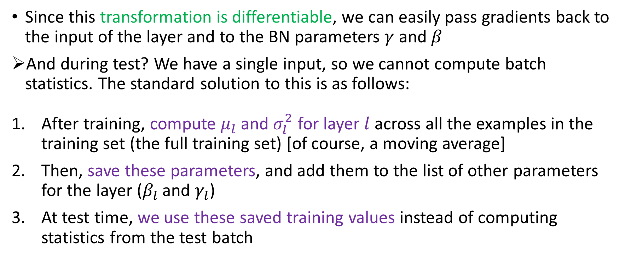
Batch Normalization – Test set
Since this transformation is differentiable, we can easily pass gradients back to the input of the layer and to the BN parameters $γ$ and $β$
And during test? We have a single input, so we cannot compute batch statistics. The standard solution to this is as follows:
After training, compute $μ_{l}$ and $σ_{l}^{2}$ for layer $l$ across all the examples in the training set (the full training set) [of course, a moving average]
Then, save these parameters, and add them to the list of other parameters for the layer ($β_{l}$ and $γ_{l}$)
At test time, we use these saved training values instead of computing statistics from the test batch
Note that, when using a model with BN, we need to specify if we are using it for inference (test) or training

Slide 47
Batch Normalization – Last words
The benefits of batch normalization (in terms of training speed and stability) are great!
Especially for deep CNNs
The exact reasons for this are still unclear
BN seems to make the optimization landscape significantly smoother
It also reduces the sensitivity to the learning rate
However, it struggles when the batch size is small
The estimated mean and variance parameters can be unreliable
One solution is to compute the mean and variance by pooling statistics across other dimensions of the tensor, but not across examples in the batch

Slide 48
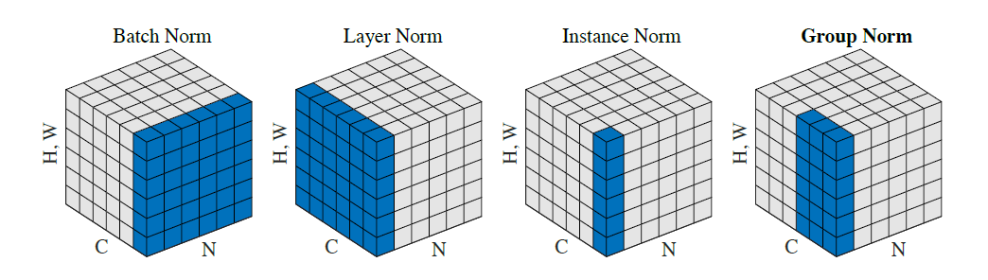
Other types of Normalization
The blue pixels within the feature map are normalized using the same mean and variance. These statistics are computed by aggregating the values of these pixels.
Batch Normalization (batch norm): Applies normalization across the entire batch.
Layer Normalization (layer norm): Normalizes within each channel independently.
Instance Normalization (instance norm): Normalizes per instance (sample) independently.
Group Normalization (group norm): Divides channels into groups (here, 2 groups of 3 channels) and normalizes within each group.
Notes:
<src. Kaiming He>
N: Represents the batch axis.
C: Corresponds to the channel axis.
(H, W): Refers to the spatial axes (height and width).

Slide 49
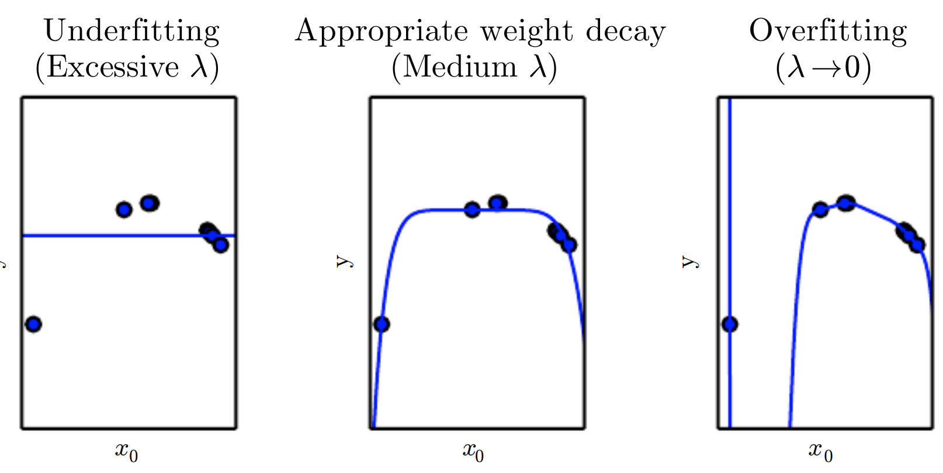
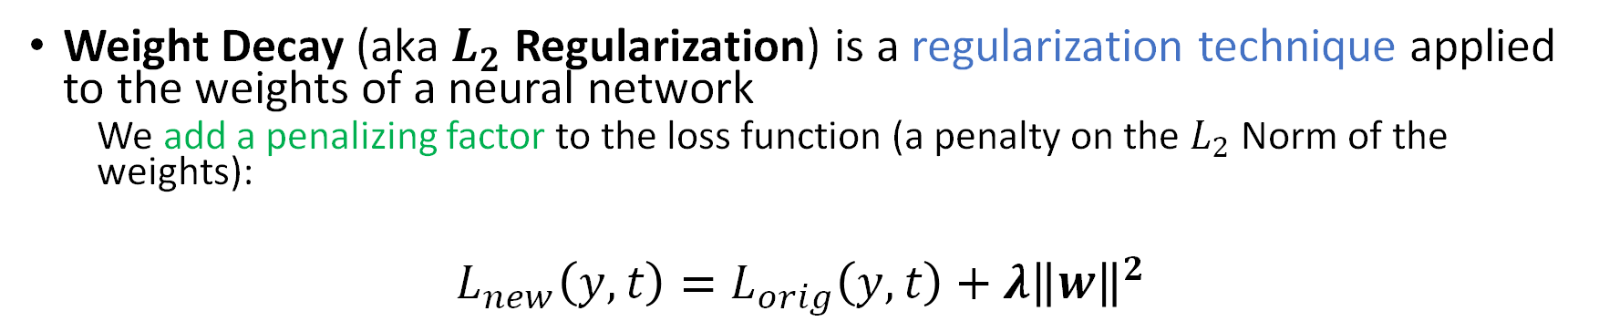
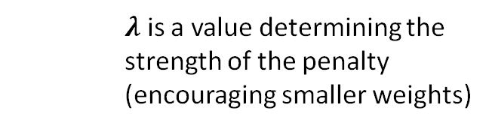
Weight Decay
Weight Decay (aka $L_{2}$ Regularization) is a regularization technique applied to the weights of a neural network
We add a penalizing factor to the loss function (a penalty on the $L_{2}$ Norm of the weights):
$$L_{new}\left(y,t\right)=L_{orig}\left(y,t\right)+λ{\left\|w\right\|}^{2}$$
$λ$ is a value determining the strength of the penalty (encouraging smaller weights)
Notes:
Image from Deep Learning, Goodfellow et al.
Weight Decay (if in the update rule), or $L_{2}$ Regularization (if in the objective function)
Lambda is usually around 0.1, 0.01, and so on, but can in theory be anything

Slide 50
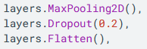
Dropout
To reduce overfitting, we can apply Dropout to the network
A form of regularization
The idea is that we let a layer to randomly drop out a few output units from the layer itself during the training process
By setting the activation to zero
We can pick the percentage of the output units that are dropped out randomly from the applied layer. Example:

Slide 51
Architecture examples
LeNet (1998)
AlexNet (2012)
GoogLeNet (2014)
ResNet (2015)
DenseNet (2016)

Slide 52
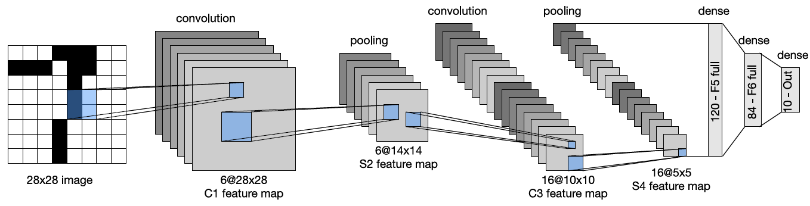
LeNet
LeNet is one of the earliest CNNs (1998), named after its creator Yann LeCun.
It was designed to classify images of handwritten digits, and was trained on the MNIST dataset
With this CNN, after just 1 epoch, the test accuracy is already 98.8%
Notes:
Note that the image of this model (LeNet5) is not scaled

Slide 53
LeNet
It uses tanh, weight decay, and alternates convolution layers and pooling layers
Notes:
Note that the image of this model (LeNet5) is not scaled

Slide 54


LeNet
$$\left(x_{h} + 2p_{h}−f_{h} + 1\right)∗ (x_{w} + 2p_{w}−f_{w}+1)$$
$p=$2
$f =$5
$x=$28
$$\left(28 + 4 −5 + 1\right)∗ \left(28 + 4 −5 + 1\right)=28∗28$$
Image is 28x28 (MNIST)

Slide 55

LeNet
$$\frac{\left(x_{h} + 2p_{h}−f_{h} +s_{h}\right)}{s_{h}}∗\frac{x_{w} + 2p_{w}−f_{w}+s_{w}}{s_{w}}$$
$p=0$
$f =$2
$x=$28
$s=2$
$\frac{\left(28 + 0 − 2 +2\right)}{2}∗\frac{\left(28 +0 −2 +2\right)}{2}=14∗1$4
Image is 28x28 (MNIST)

Slide 56

AlexNet
AlexNet model is named after its creator Alex Krizhevsky
Very similar to LeNet, with the following differences:
Is deeper (8 layers of adjustable parameters (that is, excluding the pooling layers) instead of 5)
Uses ReLU instead of tanh
Uses dropout for regularization instead of weight decay
Stacks several convolutional layers on top of each other, instead of alternating between convolution and pooling
Notes:
LeNet5, a convolutional neural net for classifying handwritten digits
The pooling layers are excluded because there are no weights in the filter to be learned

Slide 57

AlexNet
When stacking multiple convolutional layers together the receptive fields become larger
Since the output of one layer is fed into another
For example, three $3∗3$filters in a row will have a receptive field size of $7∗7$
This is better than using a single layer with a larger receptive field,
Because the multiple layers also have nonlinearities in between that helps
Also, three $3∗3$ filters have fewer parameters than one $7∗7$
Notes:
LeNet5, a convolutional neural net for classifying handwritten digits

Slide 58



AlexNet
In their paper, the authors showed how to reduce the (top 5) error rate on the ImageNet challenge from the previous best of 26% to 15%!
ImageNet is a dataset of 14M images of size $256∗256∗3$split in 20,000 classes
It was used as the basis of the ImageNet Large Scale Visual Recognition Challenge (ILSVRC), which ran from 2010 to 2018 (it used a subset of 1.3M images from 1000 classes)
Note that CNNs are not better at vision than humans
Simply, the dataset makes many fine-grained classification distinctions (“tiger” / “tiger cat”) complex for a human
Notes:
Although ImageNet is much harder than MNIST and CIFAR as a classification benchmark, it too is almost “saturated”
Check this paper out to learn more about CNN vs Humans: (A. L. Yuille and C. Liu. “Deep Nets: What have they ever done for Vision?” In: Intl. J. Computer Vision 129 (2021), pp. 781–802.)

Slide 59

GooLeNet (Inception)
GoogLeNet is a pun on Google and LeNet
GoogLeNet used a new kind of block, known as an inception block
It employs multiple parallel pathways, each with a convolutional filter of a different size
This lets the model learn the optimal filter size at each level
The overall model consists of 9 inception blocks followed by global average pooling

Slide 60


Inception module
The $1∗1$ convolutional layers reduce the number of channels keeping the spatial dimensions the same
The parallel pathways allows the model to learn which filter size to use for each layer
The concatenation block combines the outputs of all the pathways (which all have the same spatial size)

Slide 61


ResNet
The winner of the 2015 ImageNet classification challenge was a team at Microsoft who proposed a model known as ResNet
The key idea is to replace $x_{l+1}=F_{l}(x_{l})$with:
$$x_{l+1}=φ(x_{l}+F_{l}\left(x_{l}\right))$$
This is known as a residual block, since $F_{l}$ only needs to learn the residual, or difference, between input and output of this layer, which is a simpler task
The use of residual blocks allows us to train very deep models
The reason this is possible is that gradient can flow directly from the output to earlier layers (residual connections)
Notes:
The ResNet-18 architecture. Each dotted module is a residual block.
We can ensure the spatial dimensions of the output $F_{l}(x_{l})$ of the convolutional layer match those of the input $x_{l}$ by using padding.
However, if we want to allow for the output of the convolutional layer to have a different number of channels, we need to add $1∗1$ convolution to the skip connection on $x_{l}$

Slide 62

ResNet
The ResNet-18 architecture has 18 trainable layers:
There are 8 residual blocks with two $3∗3$ convolutional layers in each of them
Plus, an initial $7∗7$ convolution (stride 2) and a final fully connected layer
Notes:
The ResNet-18 architecture. Each dotted module is a residual block.

Slide 63


Two types of residual block, with and without $1∗1$ conv
This also changes the number of channels
Note that we add the output of each function to its input
Notes:
A residual block for a CNN. Left: standard version. Right: version with 1x1 convolution, to allow a change in the number of channels between the input to the block and the output.

Slide 64


DenseNet
Instead of adding them, we can concatenate outputs and inputs
This is known as a DenseNet
Since each layer densely depends on all previous layers
Notes:
Left: a densenet block concatenates the output with the input. Right: Illustration of a densenet.

Slide 65

DenseNet
The dense connectivity increases the number of parameters, since the channels get stacked depth wise
We can compensate for this by adding $1∗1$ convolution layers in between
We can also add pooling layers with a stride of 2 to reduce the spatial resolution
DenseNets can perform better than ResNets
Since all previously computed features are directly accessible to the output layer
But they can be more computationally expensive

Slide 66

Check this out:
https://www.cs.ryerson.ca/~aharley/vis/conv/
There is also a “flat” version: https://www.cs.ryerson.ca/~aharley/vis/conv/flat

Slide 67

CNNs in TensorFlow
https://www.tensorflow.org/tutorials/images/cnn

